Slide 1
Python Libraries

Slide 2
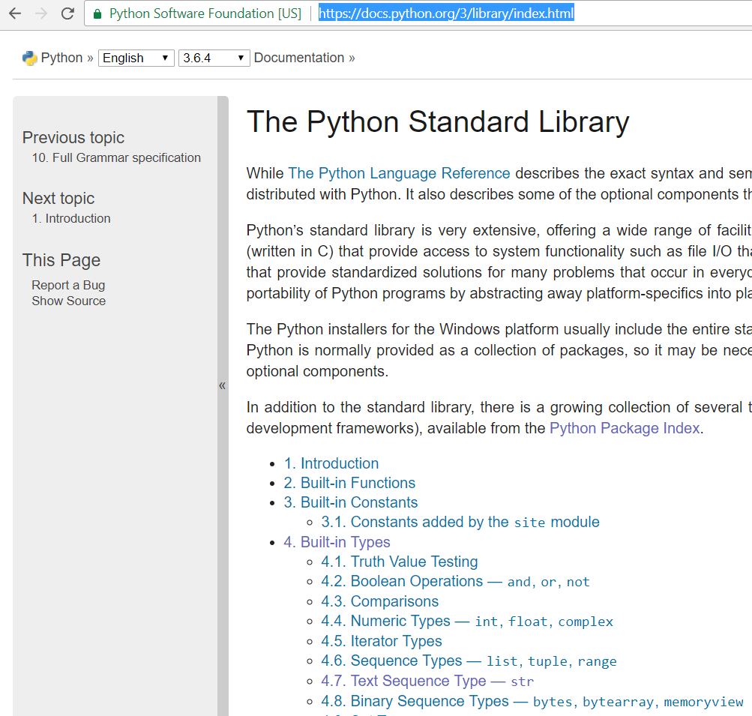
Standard Libraries includes packages used everyday, not special-purpose packages E.g. tkinter, datetime, etc. NOT numpy
https://docs.python.org/3/library/index.html

Slide 3
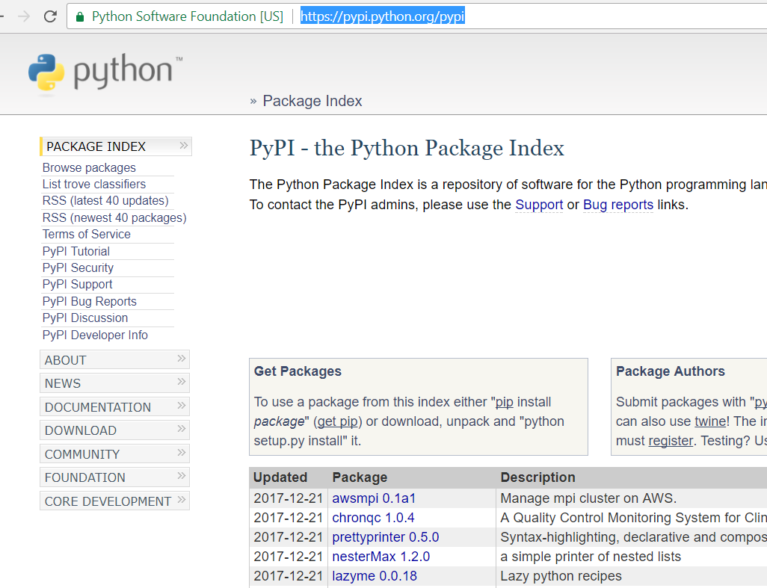
Special Purpose Libraries
Python Package Index (pypi)
https://pypi.python.org/pypi

Slide 4
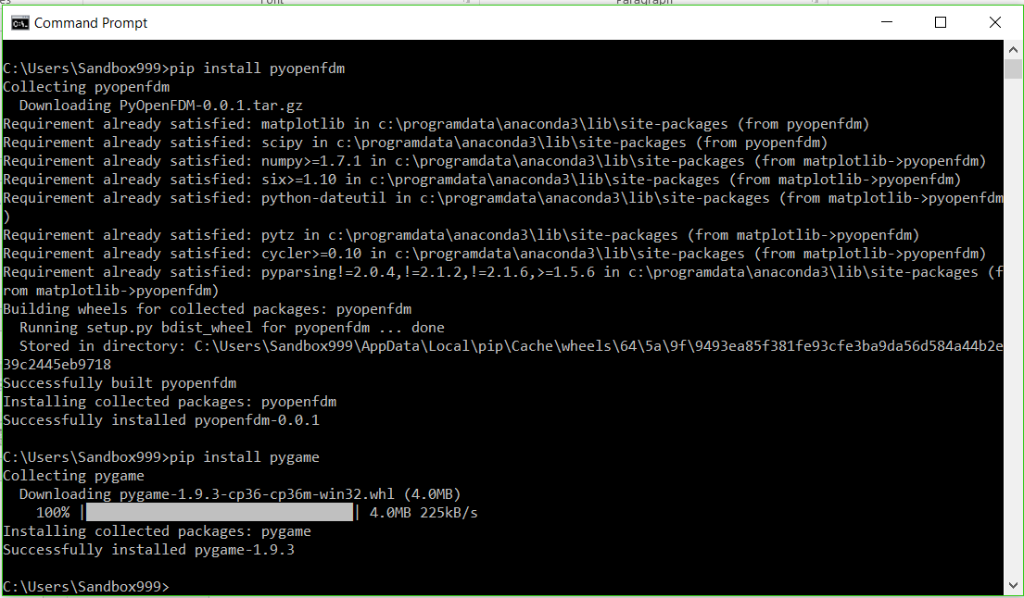
Using PIP to install pygame

